Slide 1
Adult Education Conference
October 8, 2021

Slide 2
What were your emotions when you heard that you’d have to teach students using Zoom?

Slide 3
Scared?

Slide 4
Excited?

Slide 5
What’s Zoom?

Slide 6
My Purpose today is:
What’s available on Commons to fit your needs.
Upload independent study packets on Canvas.
Create an original course for students
using Canvas.
I knew the pandemic couldn’t last forever, right?

Slide 7
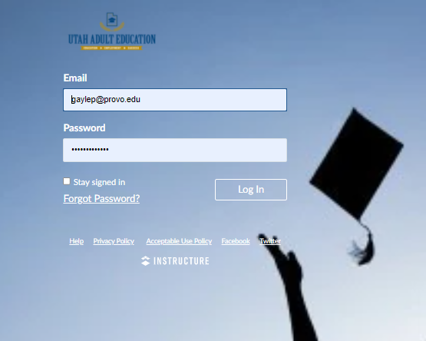
1
How to find courses on Commons, and then use them in your class:

Slide 8
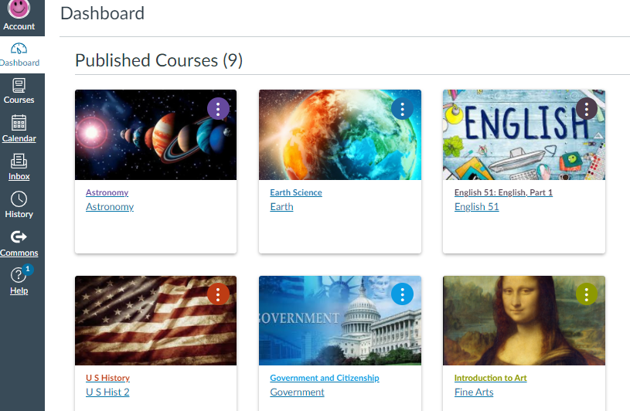

Slide 9
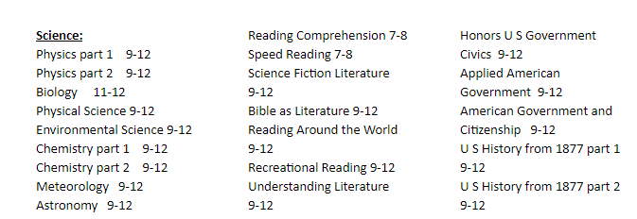
What courses are available on BYU Independent study?
This is on your handout!

Slide 10
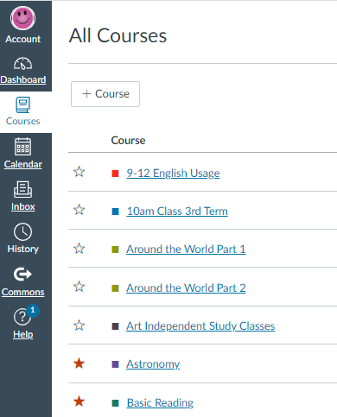
Before you import a course, you need to give it somewhere to go.
Clicking on this star will give you the course card on your dashboard.
+Course

Slide 11
Next, open up the Commons

Slide 12
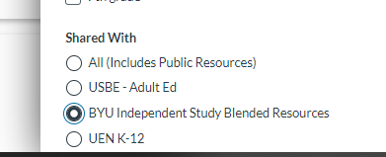
Use the filter to find content:

Slide 13
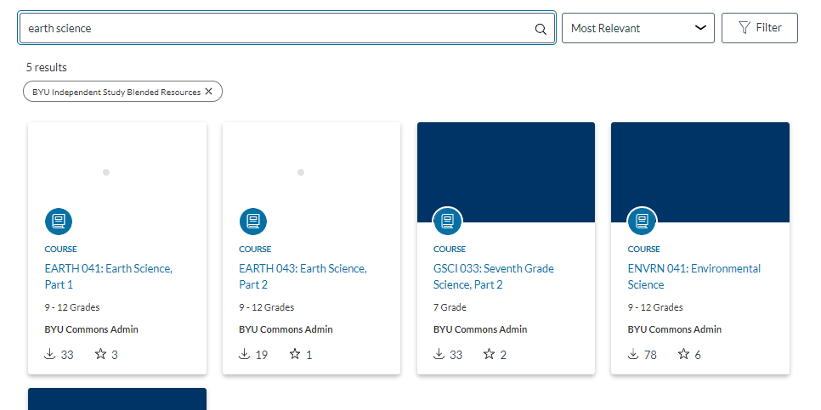

Slide 14
Import the entire course, you can modify it afterwards if you want to.

Slide 15
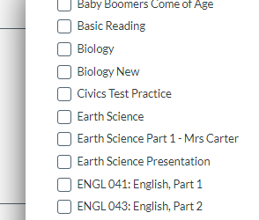
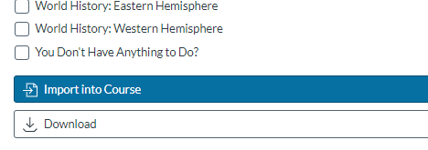
Click where you want it.
Then import!
This takes a few minutes, so don’t stress.

Slide 16
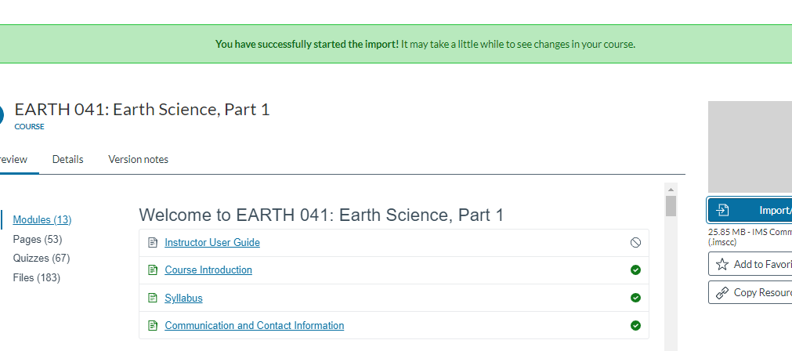

Slide 17
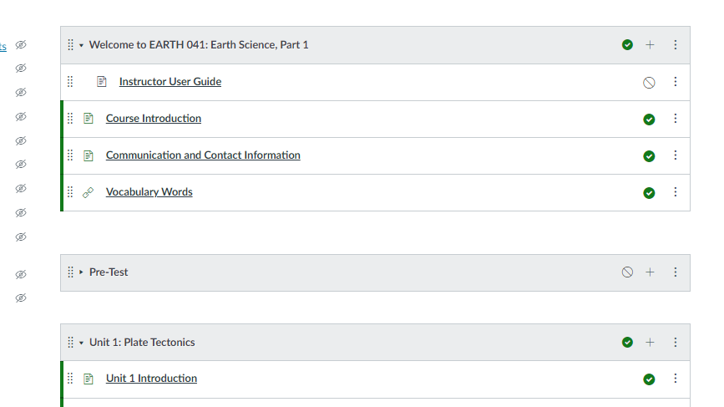
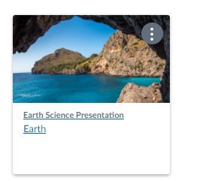
Now, go back to your dashboard and find the course.

Slide 18
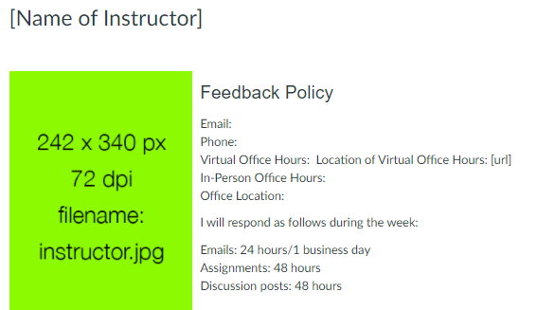
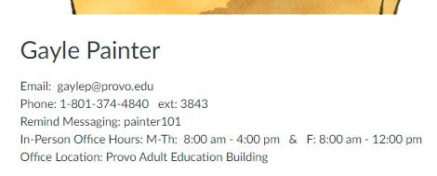
Fill in your information:
I do this once, then copy and paste for all of my other classes.

Slide 19
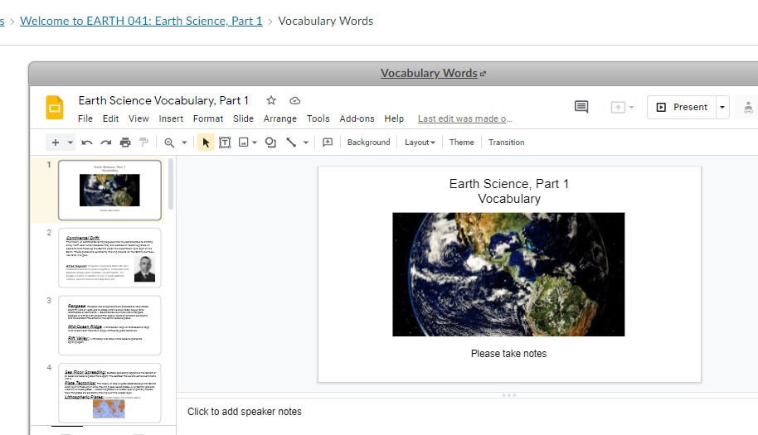
I put the vocabulary words from the Introduction onto slides

Slide 20
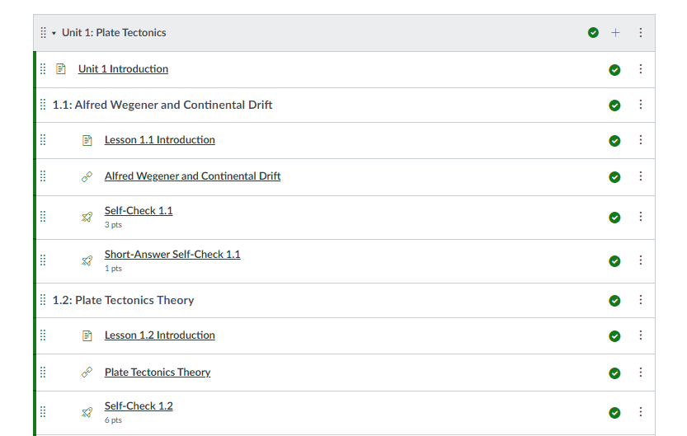
I combine the introduction and the lesson onto one google slide presentation.
1.1 for one day, 1.2 for the next, etc.

Slide 21
With the introduction and lesson combined, it looks much less intimidating for students to conquer.

Slide 22
Everything included in one lesson.
Include everything that students need to have for the complete lesson. It will be available if students miss a day, or want to go back and study more.
Review, Objective, Lesson, Questions, Videos, Pictures, Charts, etc.

Slide 23
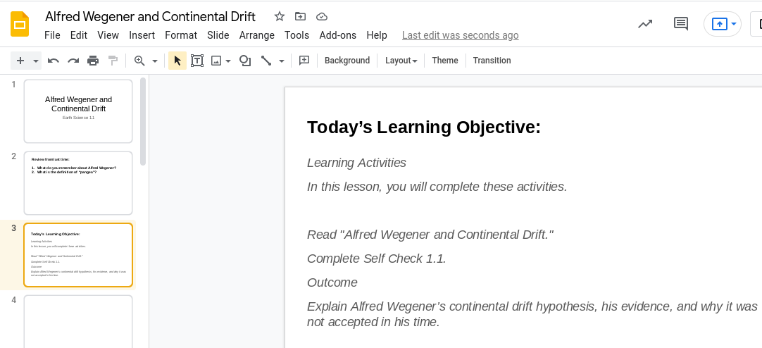
Review slide
I just copied and pasted the introduction
here.
What today’s lesson is about

Slide 24
Copy & paste the lesson onto your slides.
I put one paragraph on each slide.

Slide 25
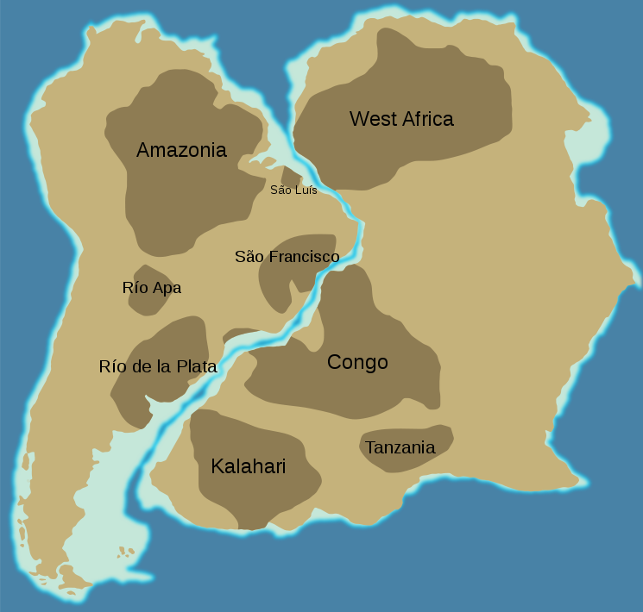
When the first maps of South America were made, cartographers and scientists noted that the shape of the eastern South American coast looked similar to the western coastline of Africa. People speculated that the two continents were once joined together.
Hey! The continents fit together like a giant puzzle.
Slide example

Slide 26
Alfred Wegener was one of the first scientists to take this idea seriously. He reasoned that if the two continents had been joined together, fossil and rock patterns along each coastline would match. He began a series of studies to see if such patterns existed, and he discovered that they did.
It’s too bad people didn’t take him seriously.
Slide example
Learn more about Continental Drift by watching this video.

Slide 27
The videos that come with the course are good, but you can’t move them around.
So, you’ll have to find videos on YouTube.

Slide 28
Short Answer:
Describe evidences that indicate all continents were once joined together.
Share your comments with me in a private chat message, or write them down, take a picture & send it to me. :)
Slide example

Slide 29
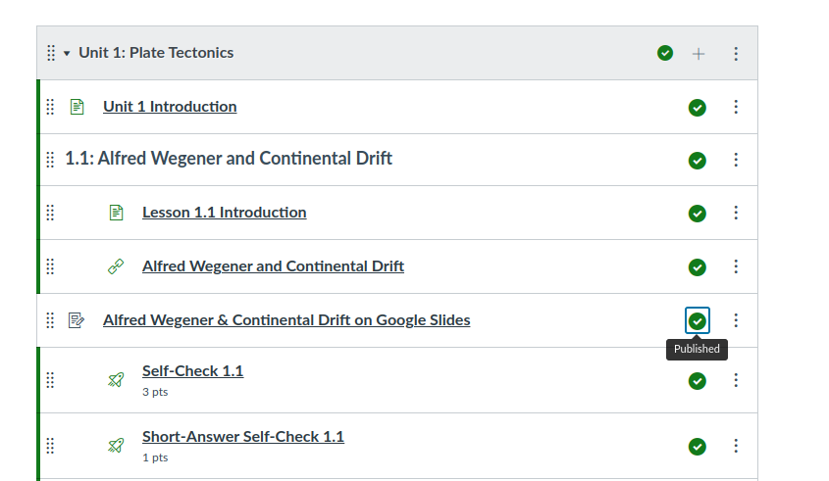
Once you have your slides complete, save them as a pdf (file/download), then upload them onto the Canvas module that you have prepared.
Original title
I always name them ______ on Google Slides
I tried to put in a link to the Google slides, but it didn’t always work well.

Slide 30
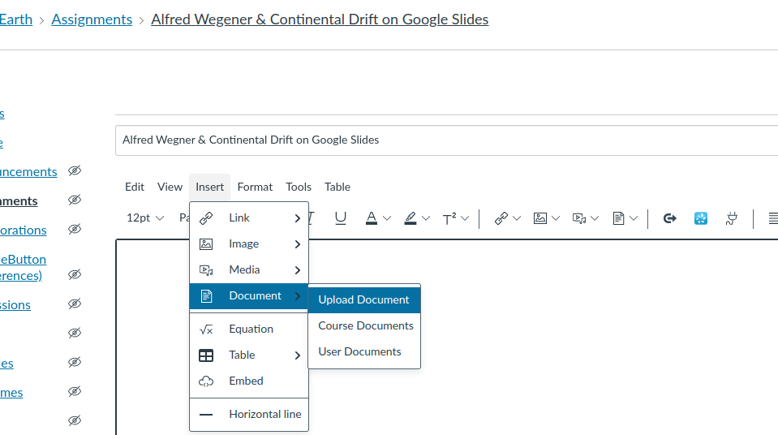
Remember to SAVE it!

Slide 31
To make the lessons more student friendly, once I have my slides uploaded, I delete all of the stuff I used.
Now, the introduction is combined with the lesson.

Slide 32
However, before you delete all the other stuff...
When I use the Safari browser, I get an audio feature on these courses. It doesn’t happen when I’m in Chrome.
So, if you have students that could benefit from listening to the lesson, you might want to leave it. You can always hide it from students until they need it.

Slide 33
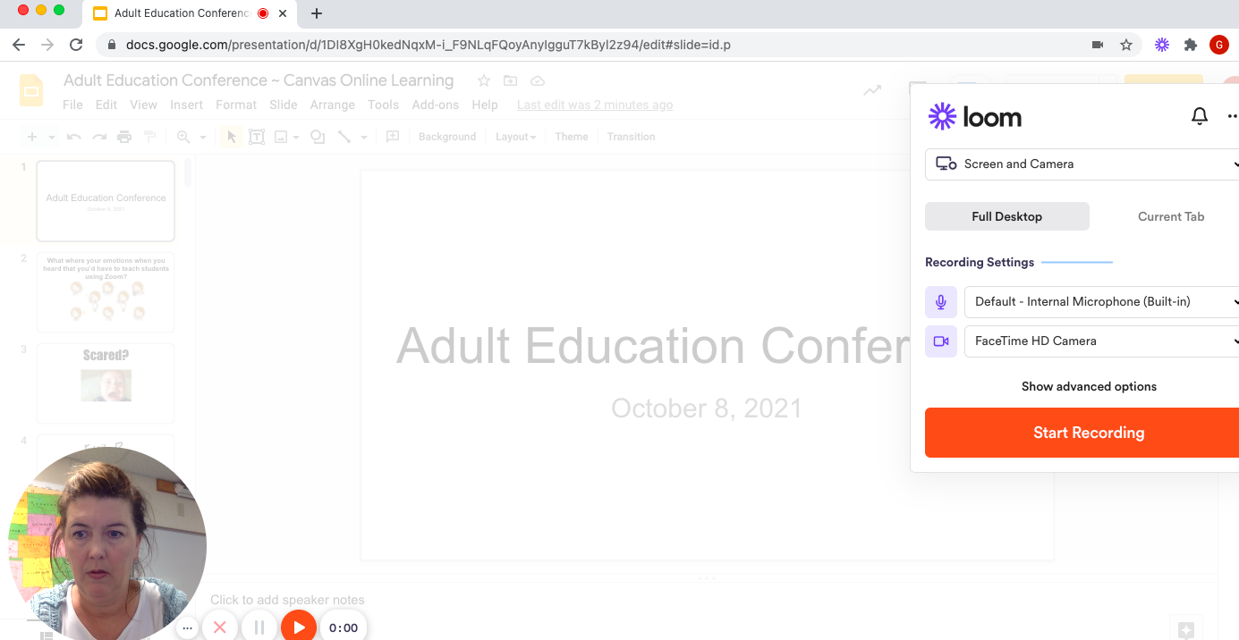
I create Loom videos of myself reading the lesson to my students.
I like to have my camera on the screen, then I can show books, maps, etc., anything I’m thinking about at the moment.

Slide 35
After you finish reading the slides, stop recording, and click “Share”.

Slide 36
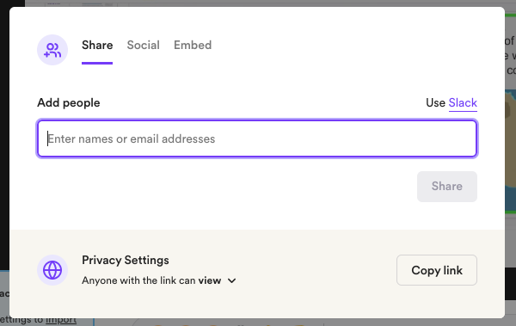
I just copy the link and paste it into Canvas. I don’t save any of my videos.

Slide 37
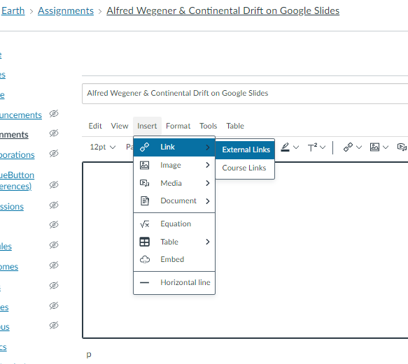
Add your Loom video here & don’t forget to scroll down and save it.
This is the same way I add the pdf slides to Canvas

Slide 38
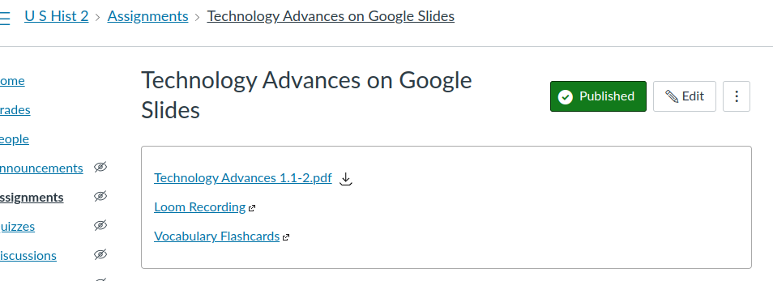
This is what it looks like:

Slide 39
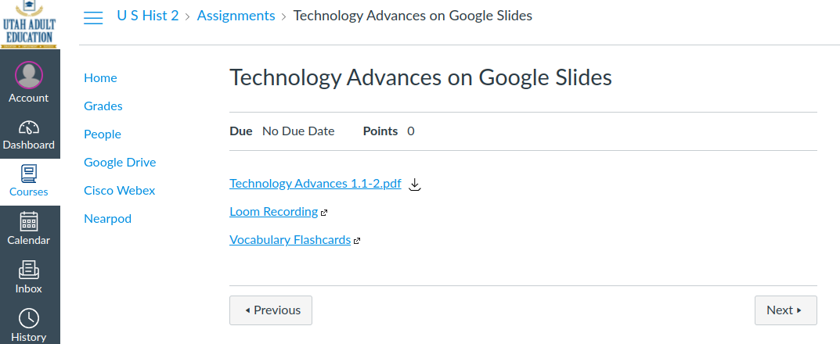
This is what the students see:

Slide 40
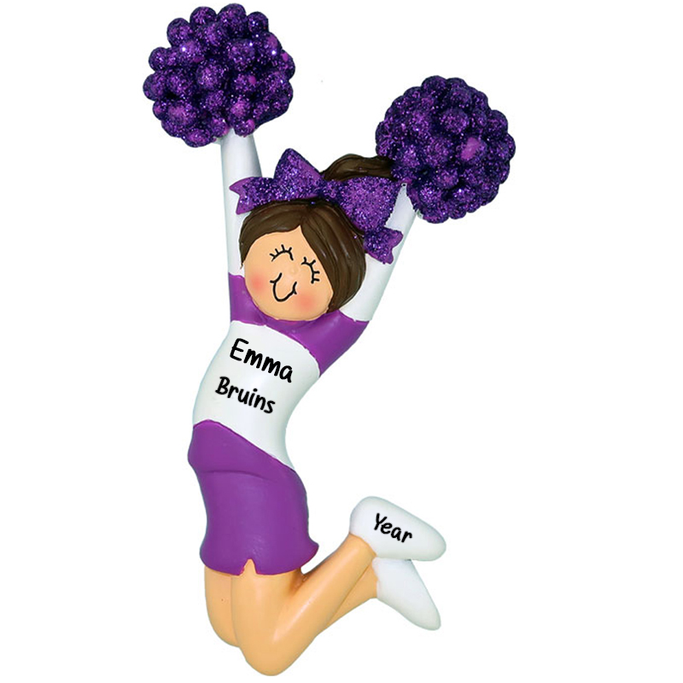
Why do this?
I wanted to create lessons that I could use on Zoom and also in-person. My Zoom recordings weren’t very good quality. I didn’t want to have to create two different sets of lessons.
I felt lots of stress because of the pandemic, and I didn’t want to start from scratch. I cheered when I found most of it was already done on Canvas.

Slide 41
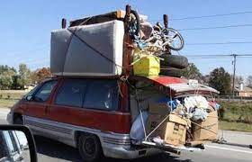
I tried to include ALL of the content. I also knew that I would need something for students who are absent. If I was going to devote all this time, I wanted to make it something I could use even after the pandemic.
Pack everything you can into each lesson.

Slide 42
Checklist:
All of the slides include teaching objectives, videos, lesson, questions, and pictures/charts/graphs etc.
I also like to add my own thoughts on the pictures or graphs too. Students can see my personality that way.

Slide 43
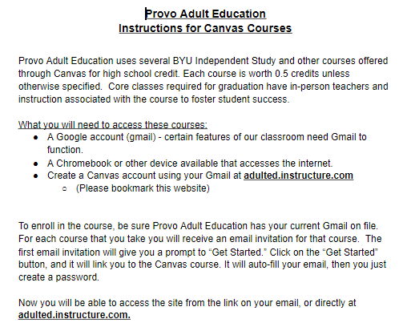
Student instructions:
This is on your handout!

Slide 44
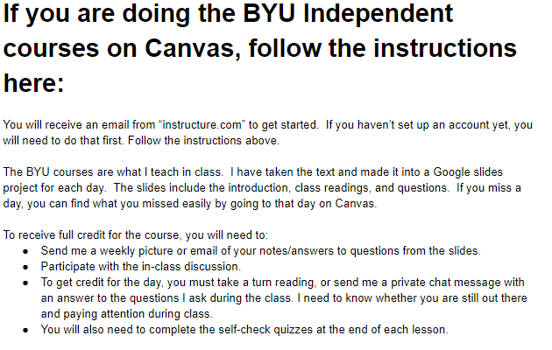
This is on your handout!

Slide 45
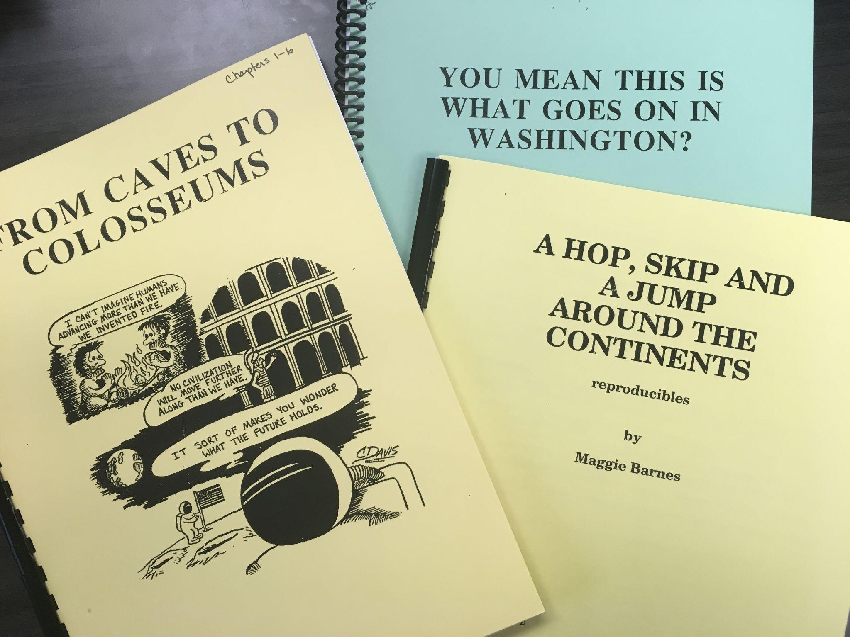
2
How to use independent study packets and upload them onto the Canvas platform:
What type of credit do your students need? What do you have available to fill that need?

Slide 46
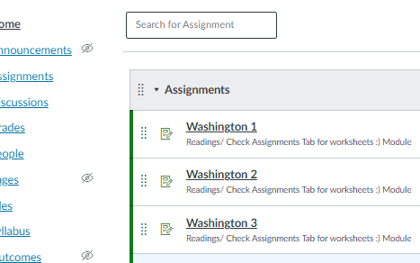
Make a single-sided copy of your independent study packet.
Separate the readings from the worksheets & tests.
Divide copies into chapters, scan, and then email them to yourself. Open your email and put the scanned copy into the modules that you created.

Slide 47
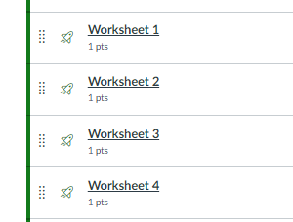
For each chapter, I scanned the pages as a continuous copy. This way the students don’t have to look through all of the pages while they answer the questions.

Slide 48
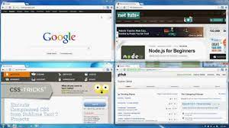
I tell my students:
When doing work on the packets it is best to open two different tabs, one for the reading and one for the worksheet, or do a split-screen.

Slide 49
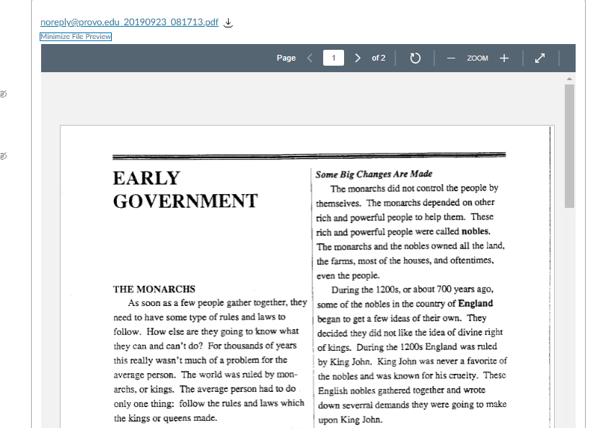
The students can scroll through the information

Slide 50
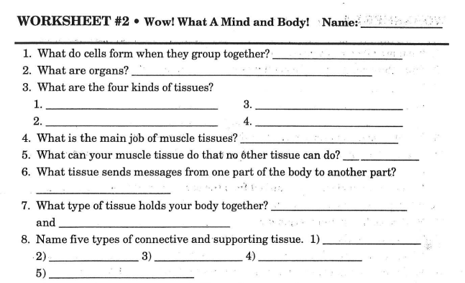
Students can print or download worksheets, or use notebooks to write their answers

Slide 51
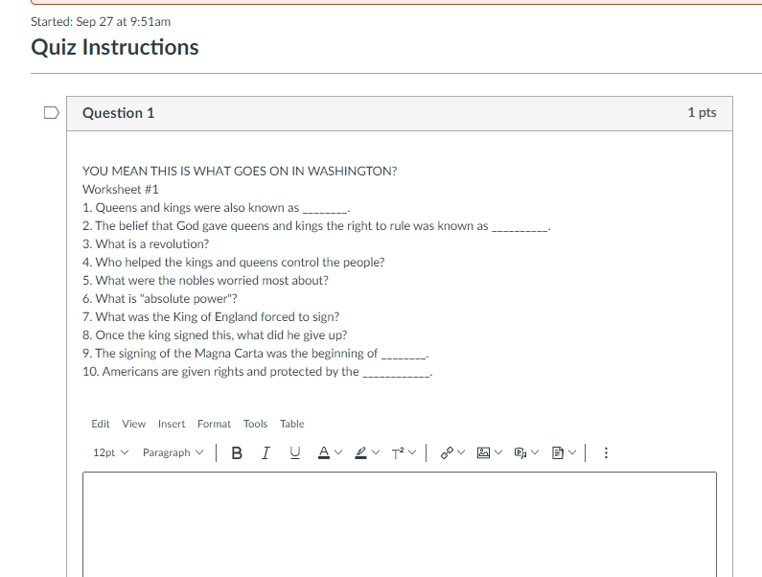
You can also create the worksheet on Canvas. Some students just copy and paste into the response box, then give their answers.
You still have to check them as you would any packet.
I tell them to write their answers in a different color, it’s easier to check that way.

Slide 52
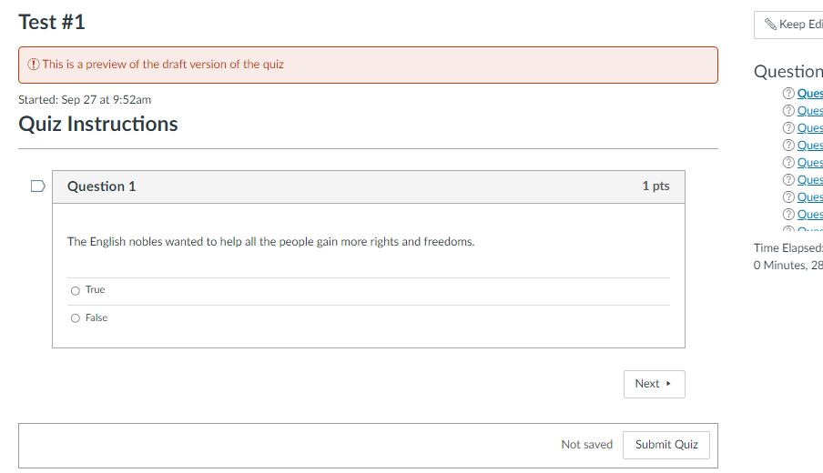
If only these test questions were done already!!!
Final test:
Speed grader! Yay!

Slide 53
3
How to create your personalized course on Canvas:
Determine your needs. For us, it was an Art class.
Start a new course
Helpful hint: Springville Art Museum gives teachers FREE art posters!

Slide 54
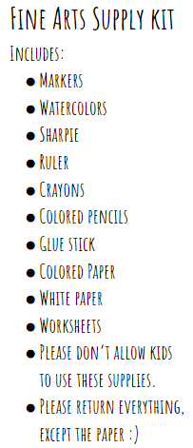
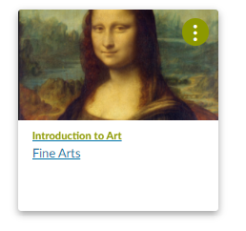
I chose art projects that use supplies students already have around the house.

Slide 55
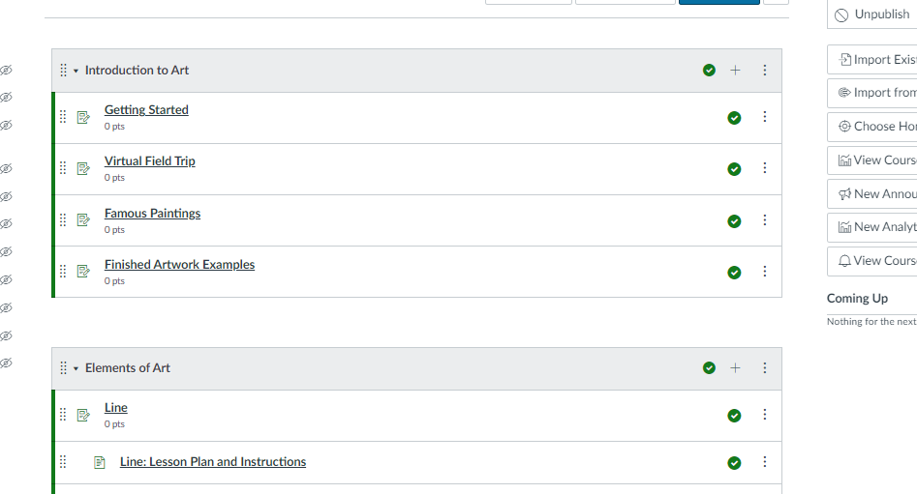

Slide 56
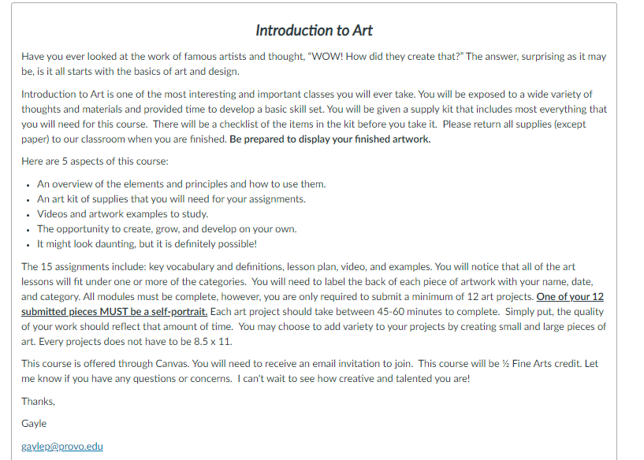
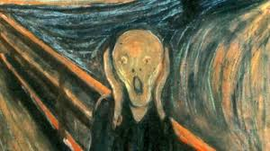
Getting Started:
Help! I don’t know what your expectations are for the class?

Slide 57
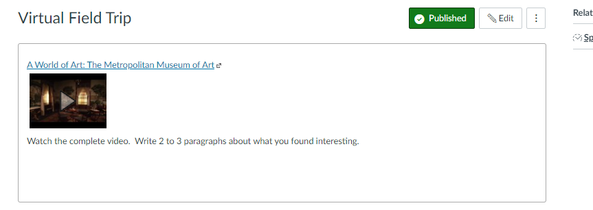
Many of my students have never been to a museum of art. I wanted to incorporate a virtual field trip to an art museum, along with a writing component, as part of the requirements for credit in this class.

Slide 58
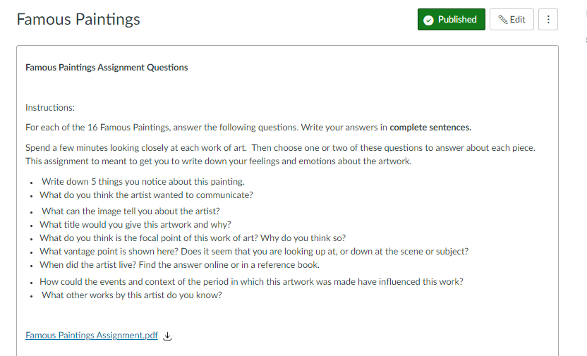

Slide 59
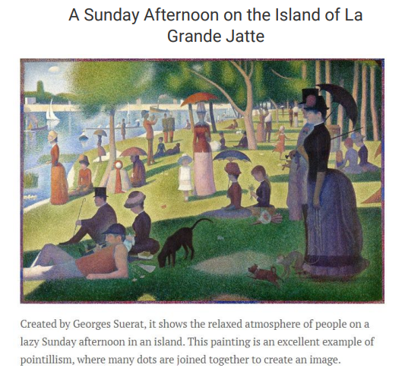
I researched what “art experts” considered to be the most famous paintings, then I assigned my students to study and write about them.

Slide 60
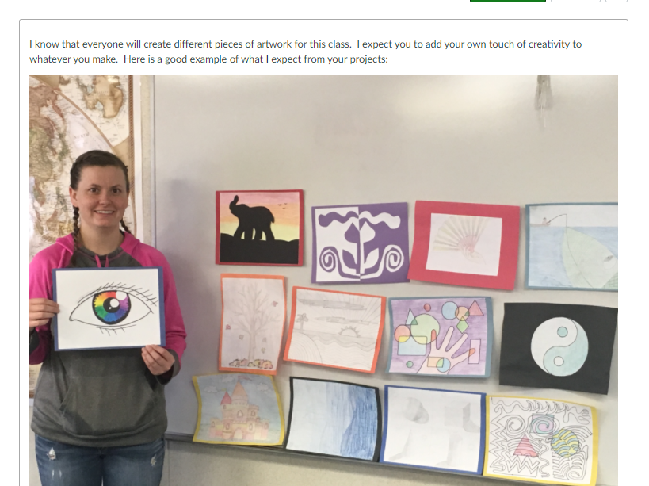
This was the first student to complete my art class!

Slide 61
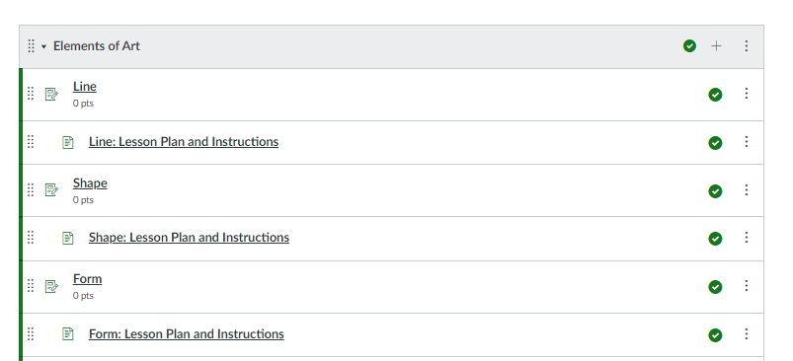
7 Elements of Art:

Slide 62
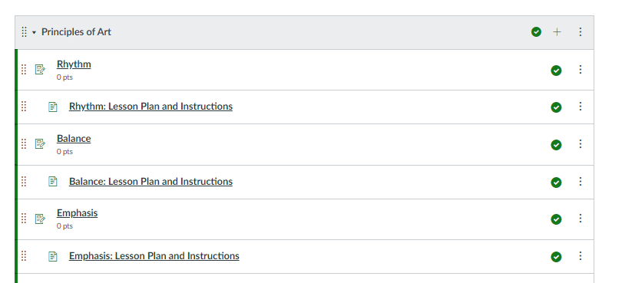
8 Principles of Art:

Slide 63
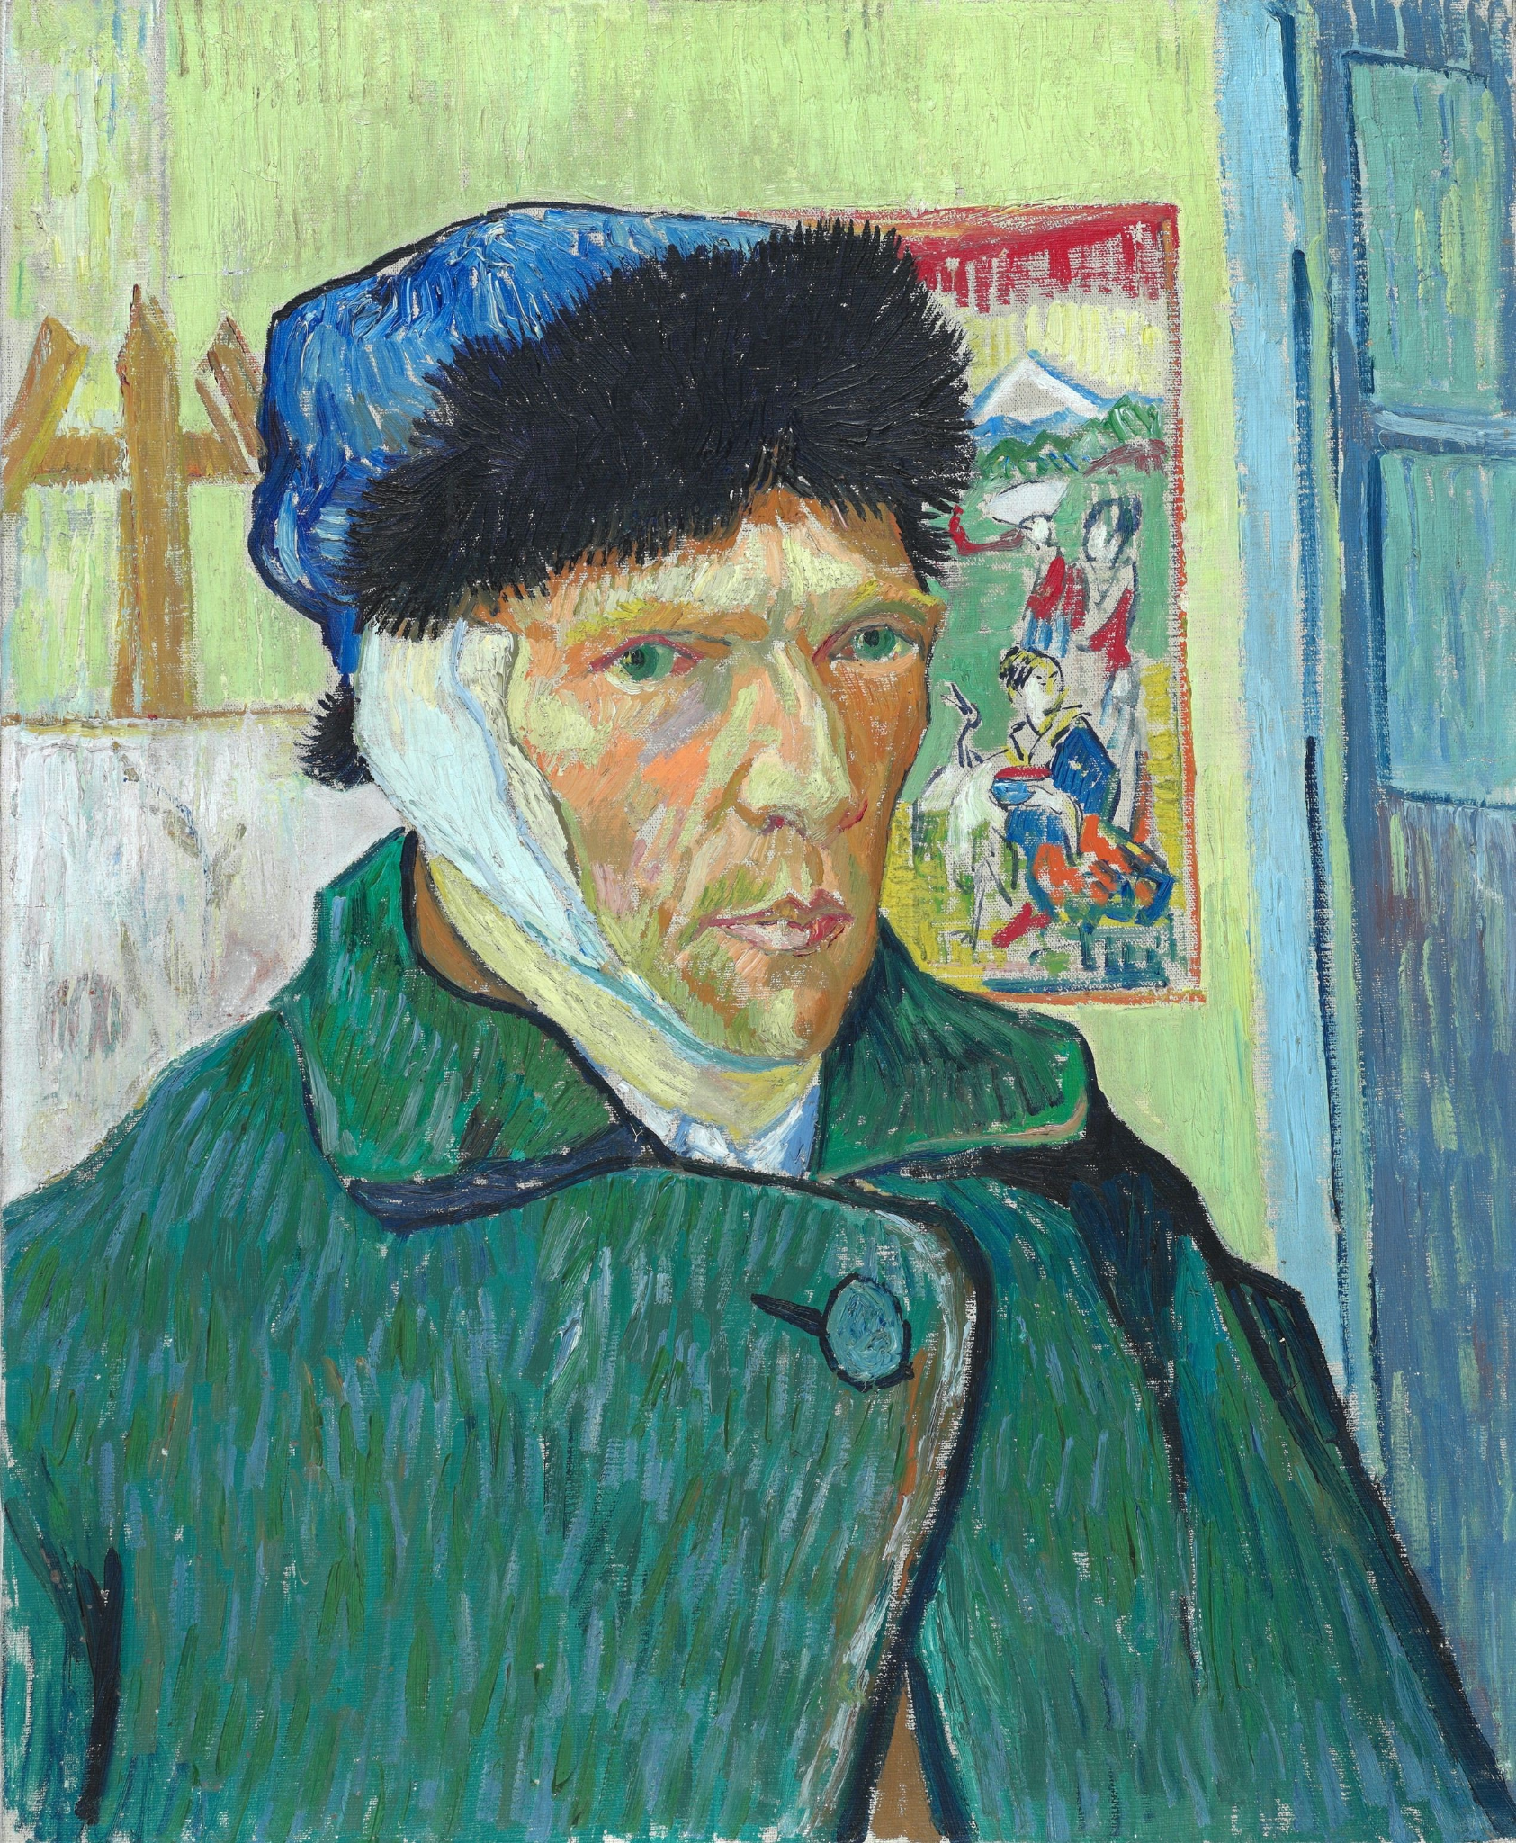
There are a total of 15 art lessons. Students are required to turn in 12 of them. One project must be a self-portrait.

Slide 64
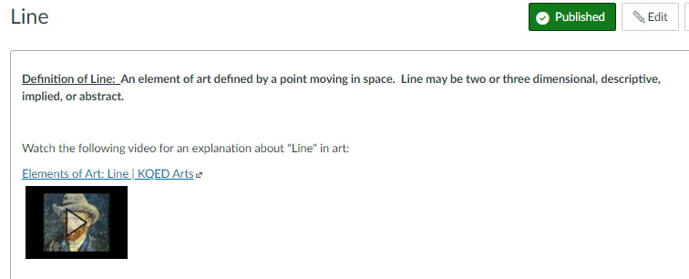
Each art lesson video is about 3 minutes long.

Slide 65
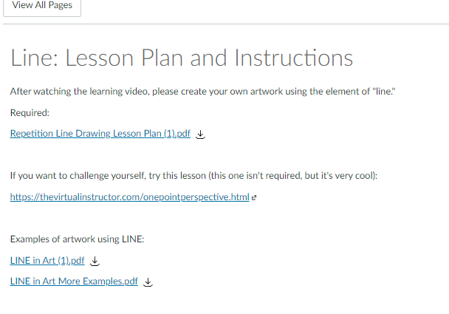
Only this one is required, the others are the challenge lesson or example pieces.

Slide 67
Most students have LOVED doing the art projects!

Slide 68
Time to wrap it up!

Slide 69
How students benefit:
Instant feedback on quizzes
Stay better informed
Handy class schedule
Many courses available
Accessible 24/7

Slide 70
Self check quizzes and tests are great instant feedback. If the self-check quizzes have any short answer questions, the students answer those and then they are sent to my computer for grading.

Slide 71
Perfect if students miss a day. This helps them stay in the loop.
All components of the lesson are right there, easy to find.

Slide 72
How Canvas benefits me as a teacher:
This has helped me to create lessons that fit my students’ needs now, and will save time for me in the future!
It’s a win-win!

Slide 73
Once the lessons are done, you can pass them around to other teachers.

Slide 74
Extra stuff:
For all of my classes, I like to copy and paste the introduction & syllabus into one document, then I use it for a discussion topic on the first day of class.
I’ve used lots of different strategies for this, such as:
KWL
Blank paper for sketching images
Current events
Any kind of graphic organizer

Slide 75
Extra stuff:
I like to use the vocabulary slides the first few days of class. We always have a lot of students that miss those days because of testing, and this is just a little bonus info for those in attendance. The others will get the same information as we go through the lessons.

Slide 77
Any questions?

